Slide 1
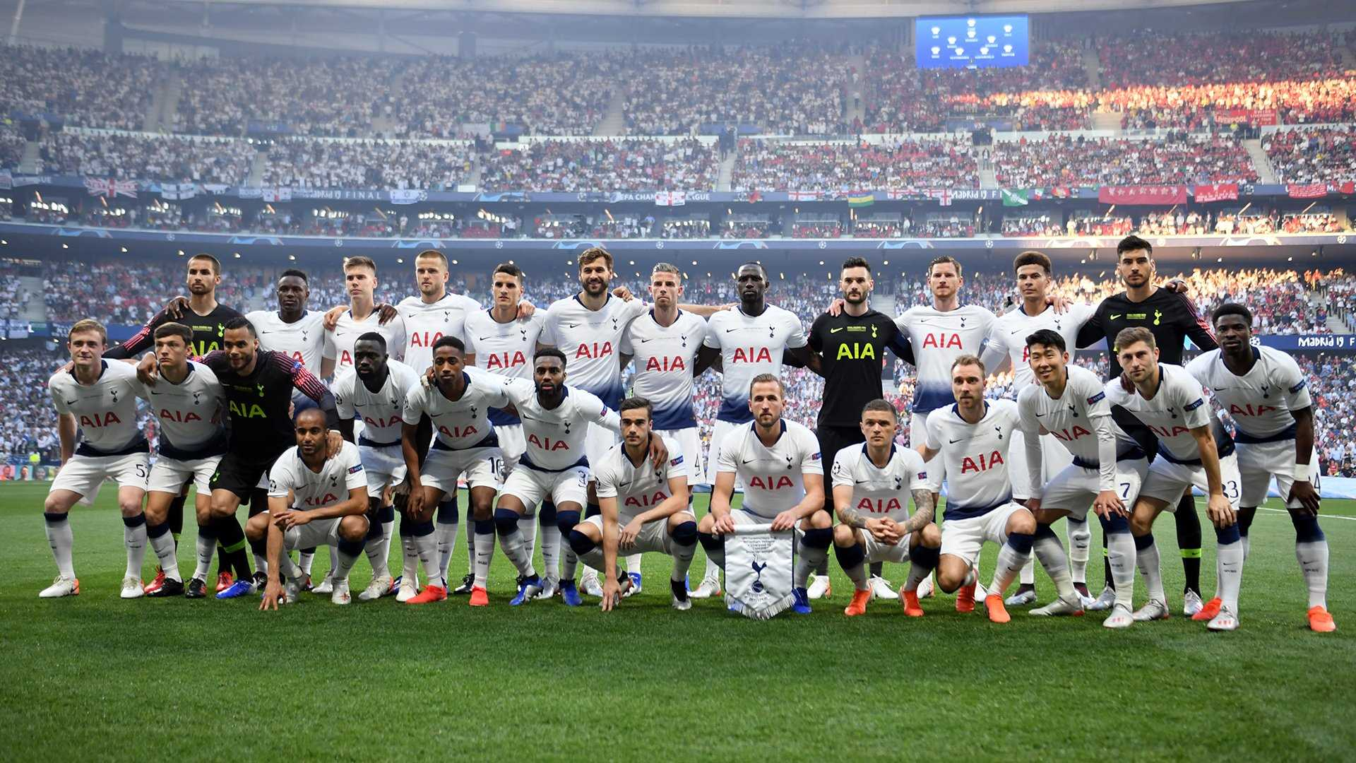

Tottenham
Hotspur Recruitment Strategy:
A Data-Driven Approach to Squad Reinforcement (2022-23)
By - Sangharsh Verma

Slide 2
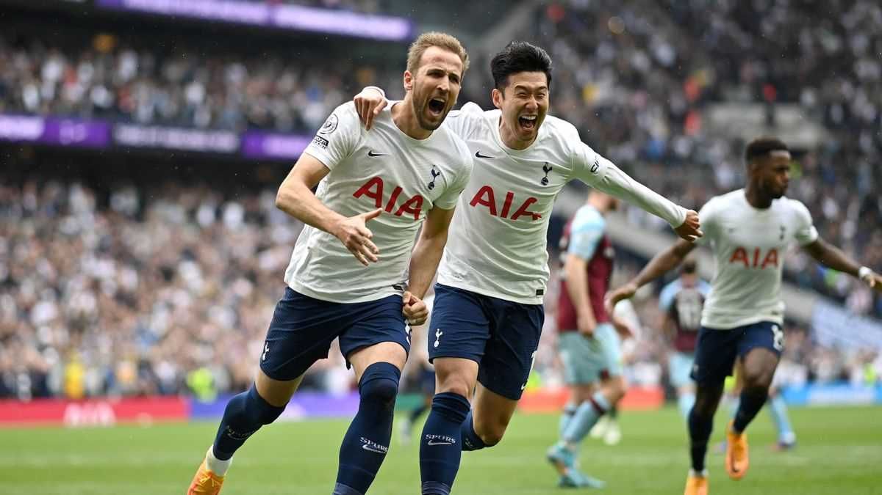
Tottenham Hotspur, commonly known as Spurs, is a renowned English football club based in North London, known for its rich history, passionate fan base, and notable achievements.
Tottenham Hotspur

Slide 3
Introduction (Context & Objective)
Why is this analysis important?
Tottenham’s key player Harry Kane is sold, leaving a major gap.
The goal: Identify replacements and strengthen the squad using data.
Approach & Methodology
Data Sources: Player & club stats from the top 5 leagues (2021-22).
Tools Used: Spreadsheets for data processing, Tableau for visualization.
Process
Squad assessment → Identify gaps → Find targets → Compare & decide.

Slide 4
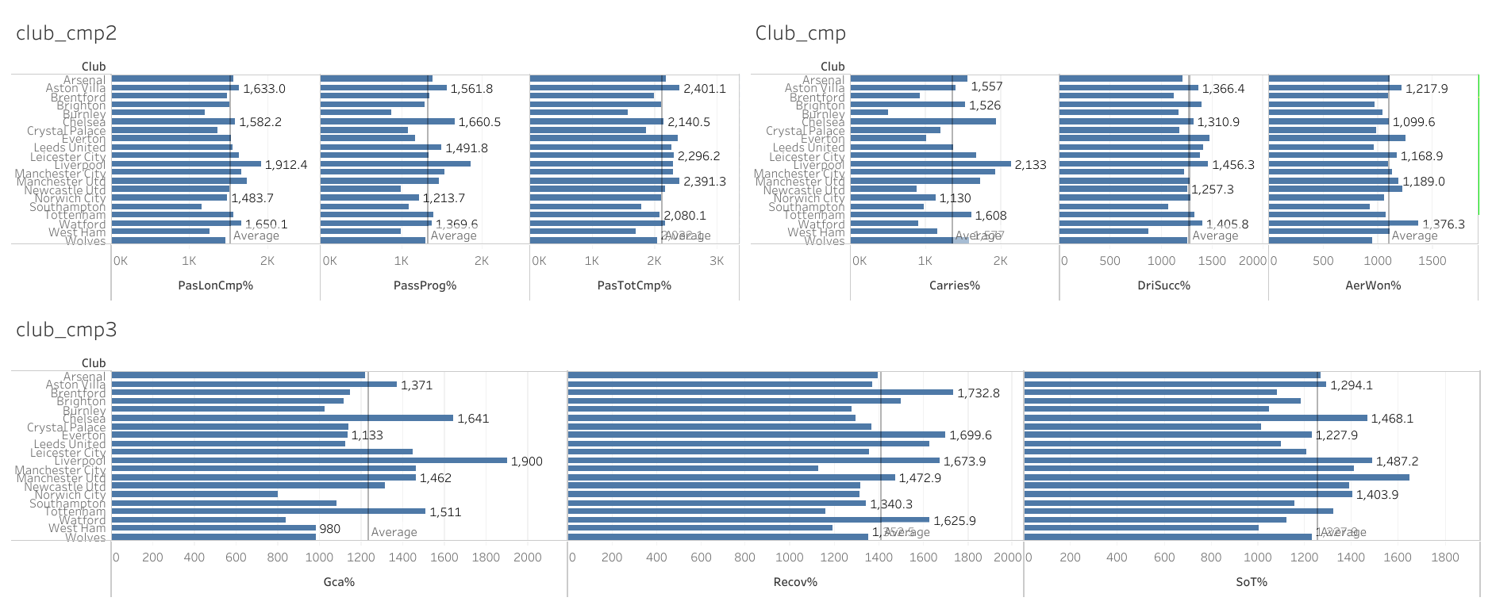
Tottenham Vs Other Clubs
Comparing different club based measures of Tottenham with other clubs in the league

Slide 5
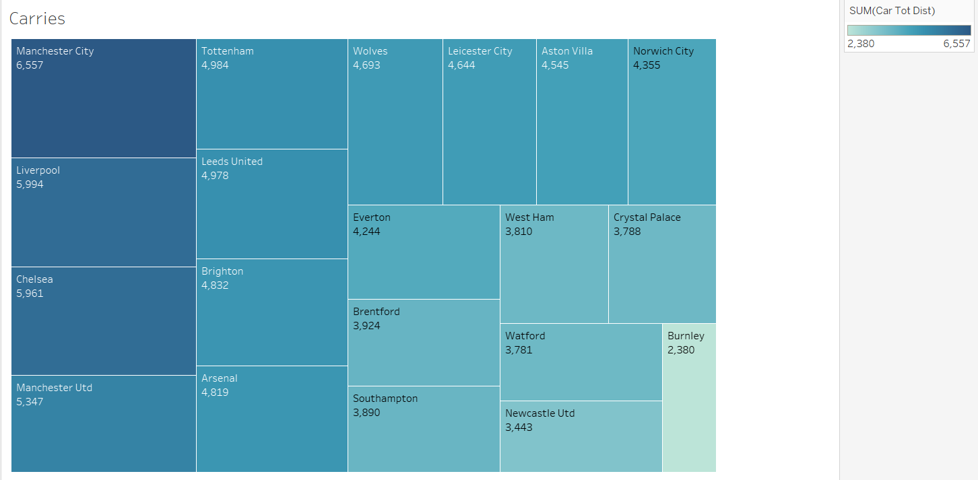
Tottenham Vs Other Clubs
A treemap showing the number of successful carries in the league club wise

Slide 6
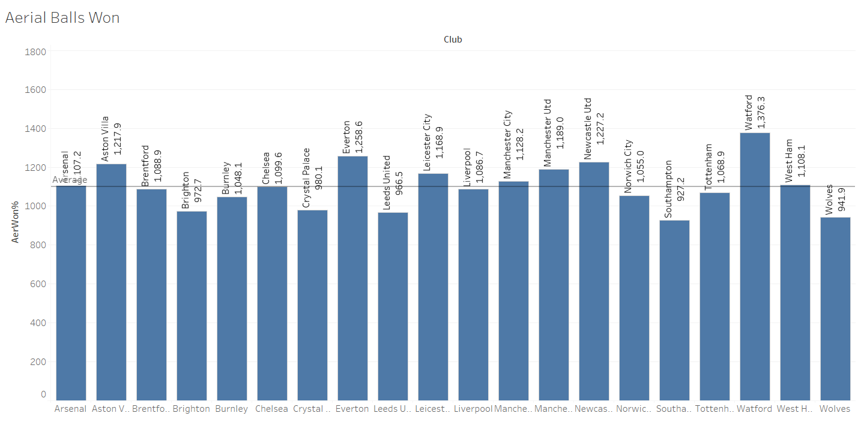
Tottenham Vs Other Clubs
A Bar Graph showing the number of Aerial Balls Won club wise

Slide 7
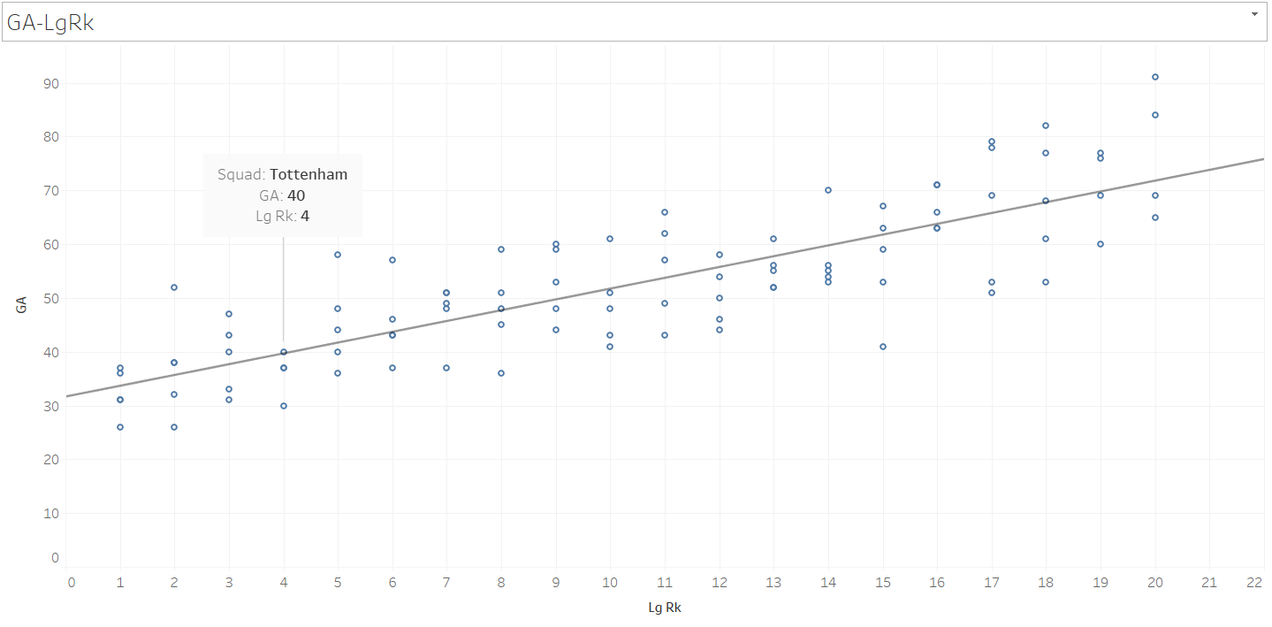
Tottenham Vs Other Clubs
A Scatter Plot showing Goals Conceded by the club against the league rank

Slide 8
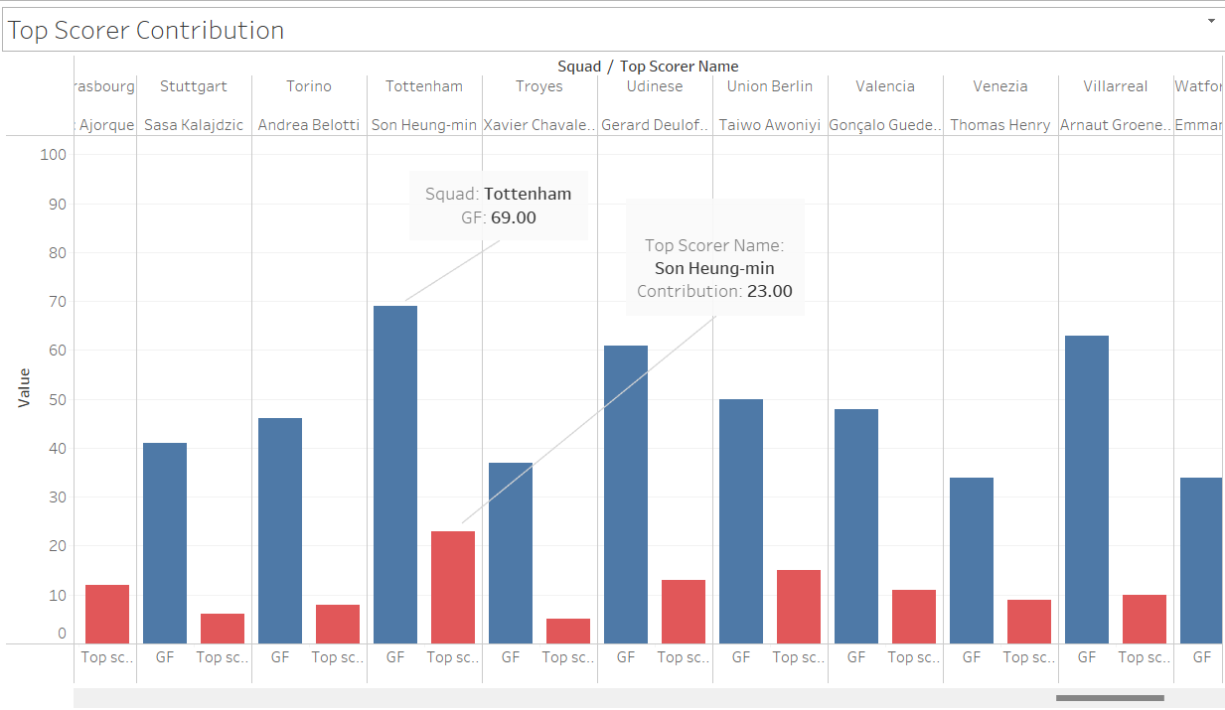
Tottenham Vs Other Clubs
A Double Bar Graph showing the contribution of the Top Goal Scorer of the Club with the Total Goals Scored by the club

Slide 9
Tottenham Vs Other Clubs
Key Issues
Low pass completion rate
Below avg carries dribbles and very less aerwon%
Very low recovery
Over dependence on Top Contributor
Lack of experienced youth
Goal Conceded are higher than any other top 4 team

Slide 10
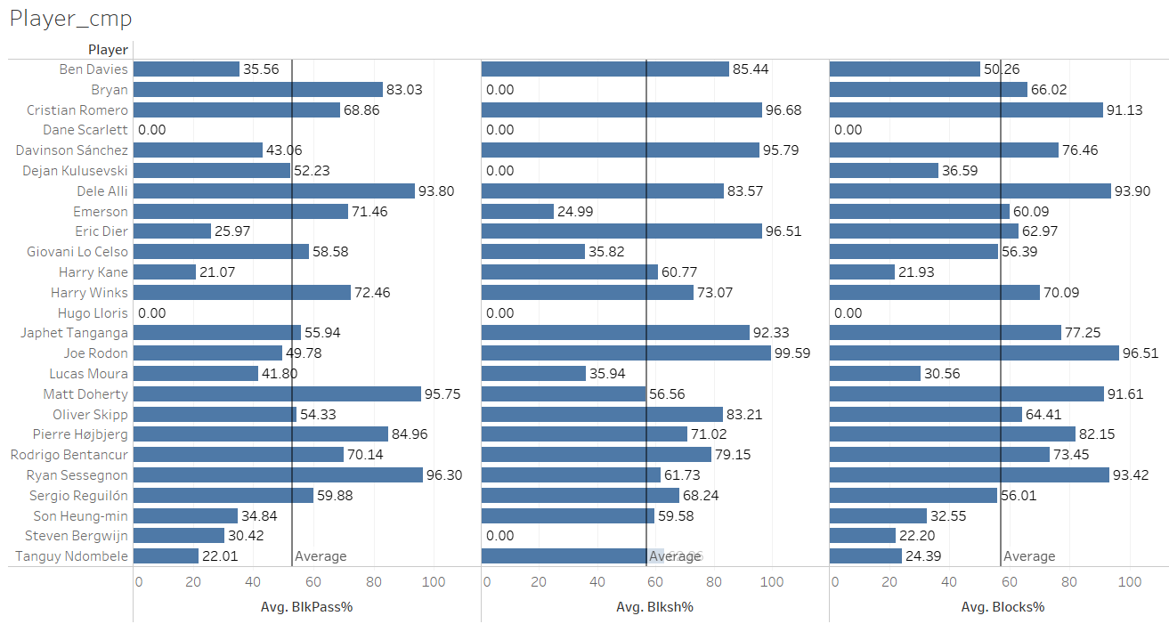
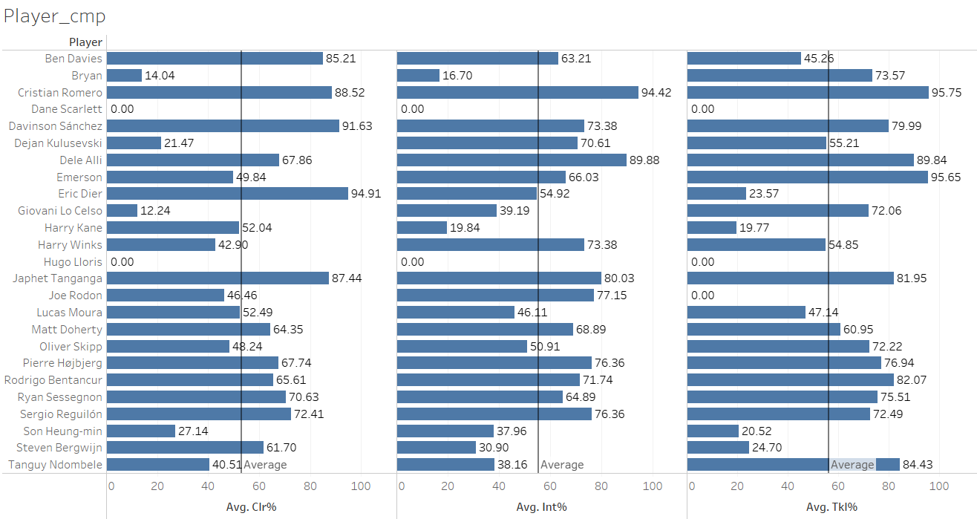
Tottenham’s Current Squad Analysis
Visualizations
Comparing measures Blocks, Blocked Passes and Blocked Shot
Comparing measures Clearance, Interceptions and Tackles

Slide 11
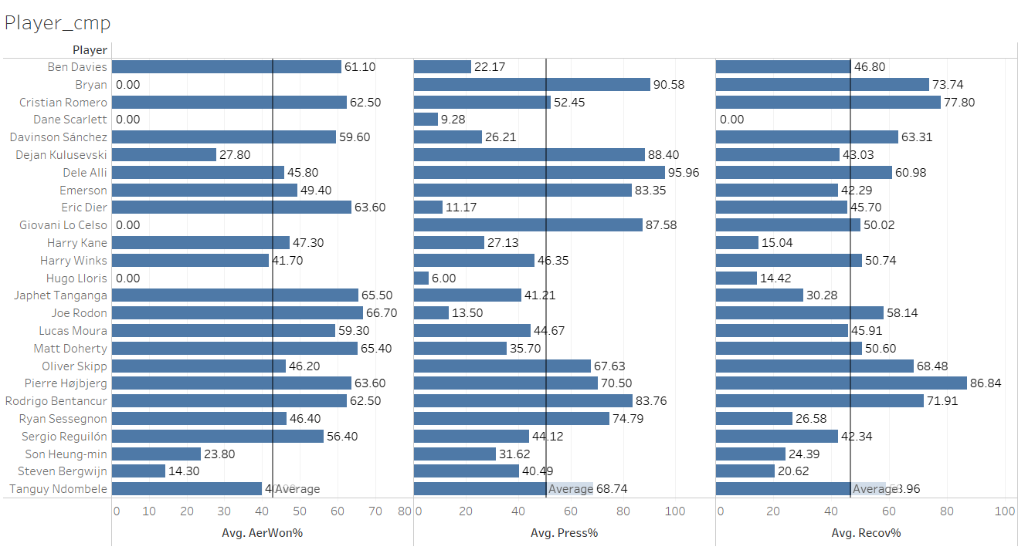
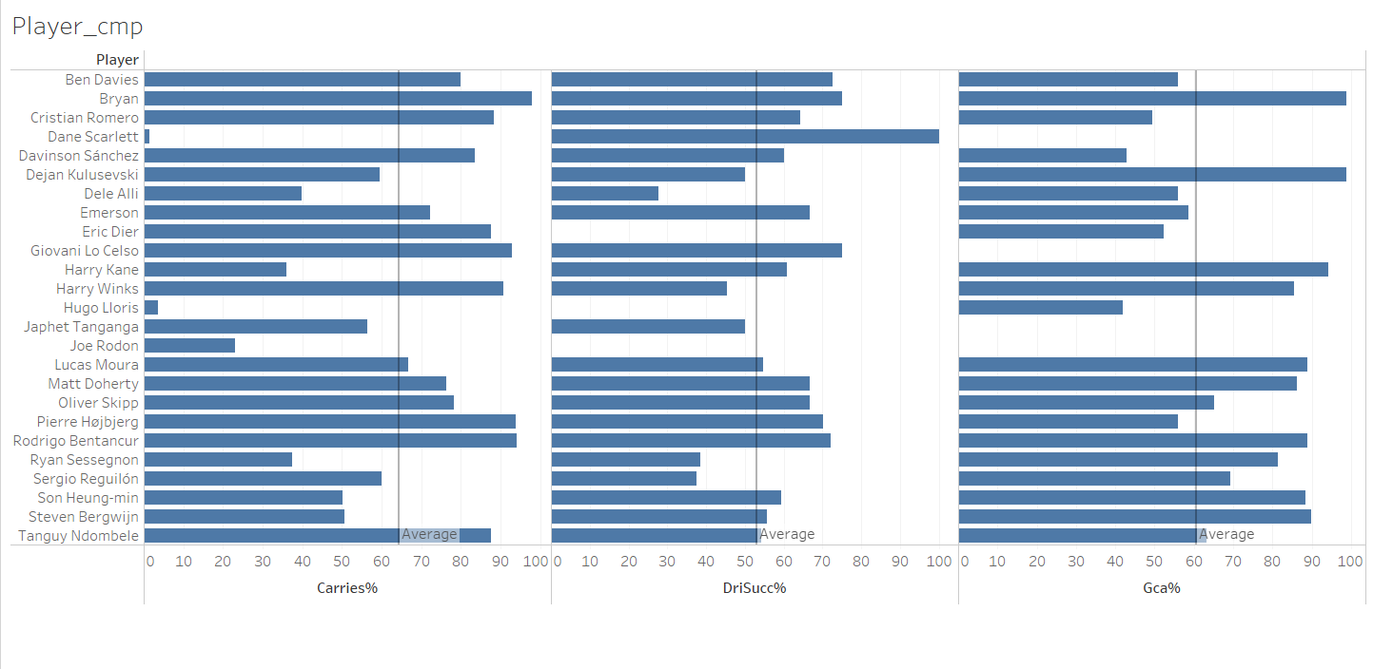
Tottenham’s Current Squad Analysis
Visualizations
Comparing measures Aerial Balls won, Press and Recovery.
Comparing measures Carries, Successful Dribbles and GCA (Goal Creating Actions).

Slide 12
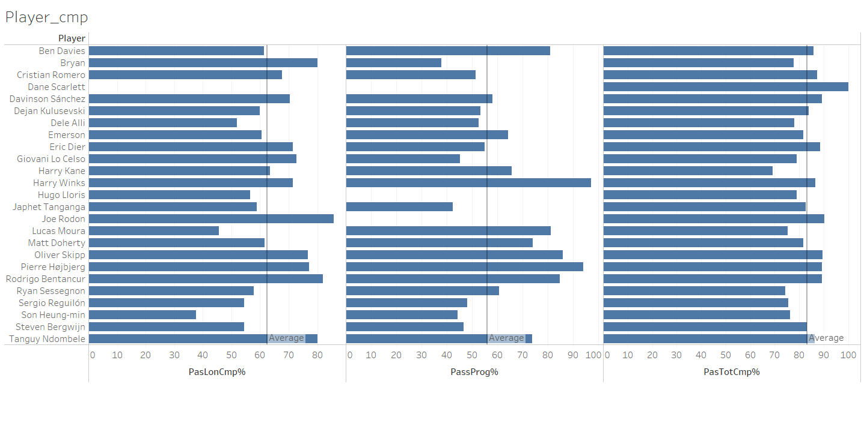
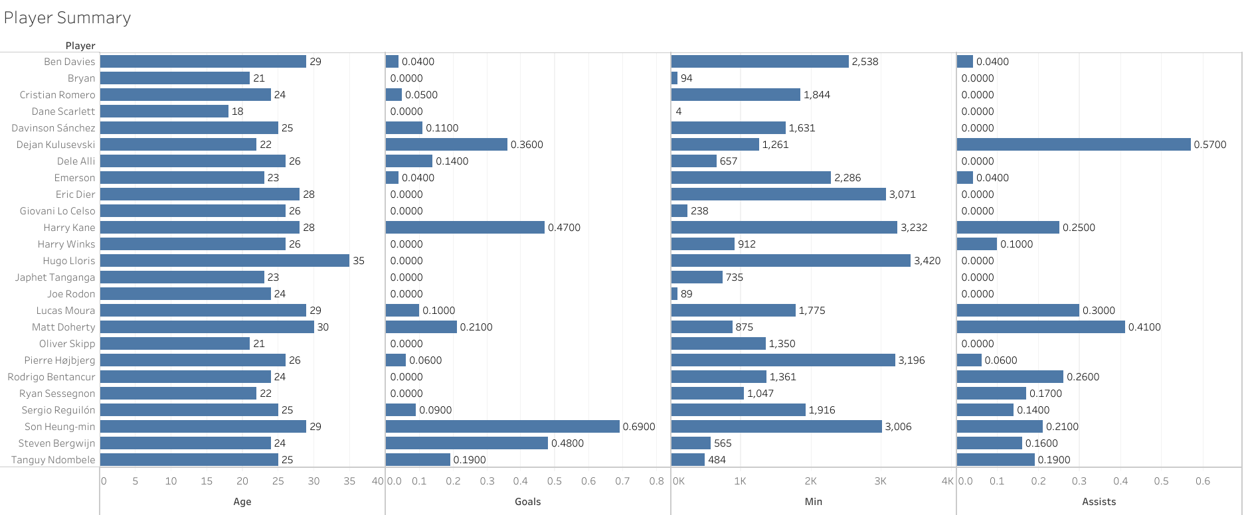
Tottenham’s Current Squad Analysis
Visualizations
Comparing measures Long Passes, Progressive Passes and Total Passes.
Comparing measures Age, Goals, minutes Played and Assists.

Slide 13
Squad Weaknesses & Areas to Improve
Insights
Key questions:
Is goal-scoring a issue without Kane?
Is the midfield creative enough?
Are there defensive weaknesses?
Which positions need strengthening?
Attack: Need a clinical finisher.
Midfield: Need a creative playmaker.
Defense: Need a stronger center-back.
Additionally
Need a marquee signing
Focus on Offensive Fullbacks
Increase the squad depth

Slide 14
Who to Sell & Who to Loan?
Player | Position | Market Value (€) | Annual Wage (£) | Reason to Sell
Ndombele | Midfielder | 30m | 10.4m | High wages, low work rate, struggled a lot in Eng
Lo Celso | Creative Mid | 20m | 3.8m | Doesn’t fit the plans, inconsistent
Harry Winks | Midfielder | 20m | 2.6m | Limited impact, doesn’t offer much
Sánchez | Center Back | 30m | 3.9m | Poor consistency, error-prone, not first-choice CB
Matt Doherty | Full Back | 15m | 3.4m | Struggled at Spurs, inconsistent performances
Bergwijn | Winger | 20m | 3.8m | Needs regular game time, inconsistent as backup
Bryan Gil | Winger | 20m | 2.6m | Lacks physicality for the Eng, better in Spain
Emerson | Full Back | 25m | 3.9m | Poor attacking full-back, struggles in final third
Eric Dier | Center Back | 20m | 3.7m | Inconsistent, Error Prone, Slow
Selling these players could raise approximately €120M+ to reinvest in stronger reinforcements.

Slide 15
Who to Sell & Who to Loan?
Player | Position | Market Value (€) | Annual Wage (£) | Reason to Loan
Japhet Tanganga | Center Back | 10m | 1.04m | Needs regular minutes, injury-prone, backup level right now
Oliver Skipp | Midfielder | 15m | 1.04m | Needs full season after injury to regain sharpness
Ryan Sessegnon | Full Back | 18m | 3.12m | Needs consistent game time to develop further
Brandon Austin | Goalkeeper | 300k | 780k | Needs game time, unlikely to play ahead of Lloris or another signing
Joe Rodon | Center Back | 8m | 1.5m | Young, needs game time probably in championship
These players have potential but need regular minutes elsewhere to develop.

Slide 16
Identifying Potential Transfer Targets
Position | Potential Targets
Striker | Dusan Vlahovic, Chris Wood, Ivan Toney, Gerard Moreno, Antoine Griezmann, Joao Pedro, Ollie Watkins
Creative Midfielder | James Maddison, James Ward Prowse, Harvey Barnes, Mattia Zaccagni, Marcel Sabitzer, Jeremie Boga
Center Midfielder | Youri Tielemans, Riqui Puig, Caicedo, Milinkovic Savic, Andre Gomes, Mac Allister, Pascal GroS
Winger | Olise, Oussama Idrissi, Christian Pulisic, Thomas Lemar, Mikel Oyarzabal, Iago Aspas, Ferran Torres
Left Back | Max Aarons, Dimarco, Balde, Lamptey, Dumfries, Digne
Right back | James Justin, Wan Bissaka, Mittelstadt, Ricardo, Estupinan, Frimpong, Zanoli
Center Back | Bremer, Tomori, Bastoni, Botman, Lacroix, Schlotterbeck, Kounde
These Players have been identified as Potential Candidates for recruitment

Slide 17
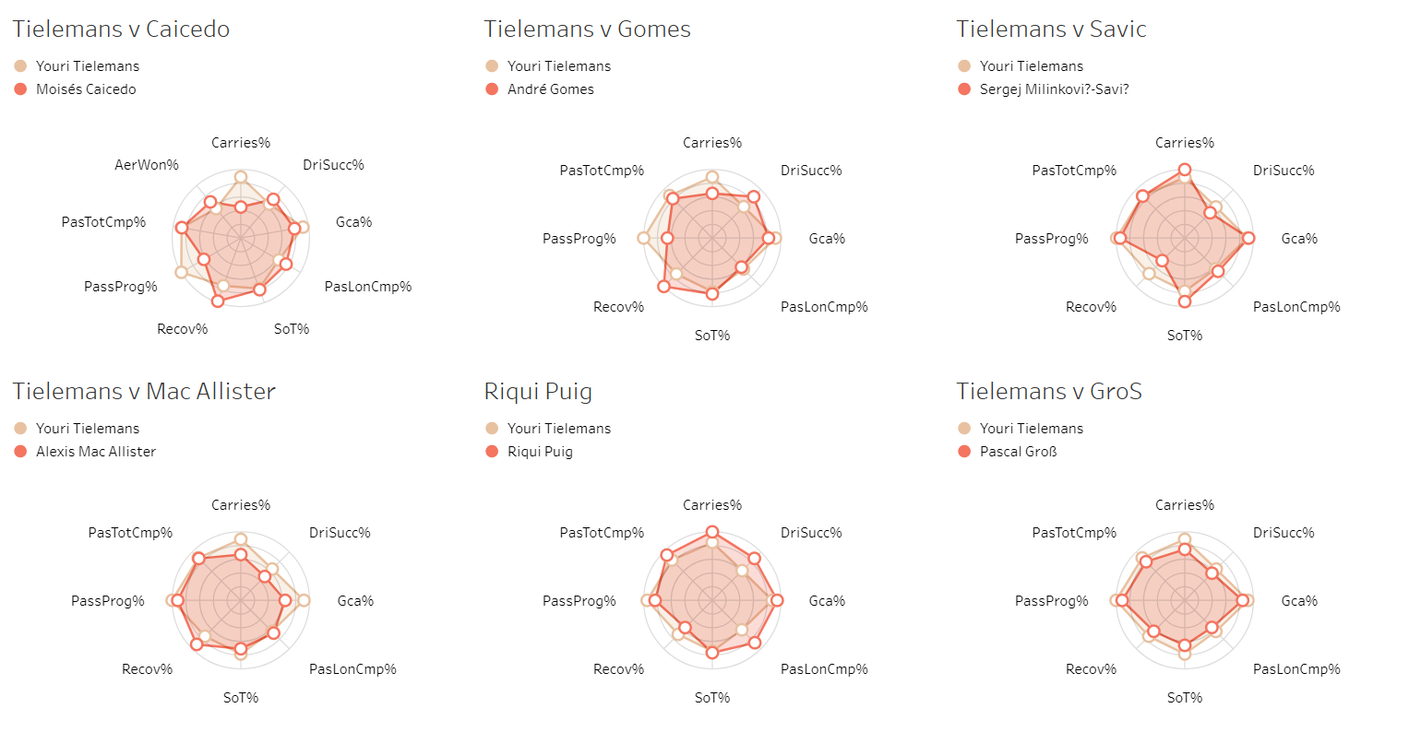
Radar Chart Comparison of Shortlisted Players
Midfielder Comparison

Slide 18
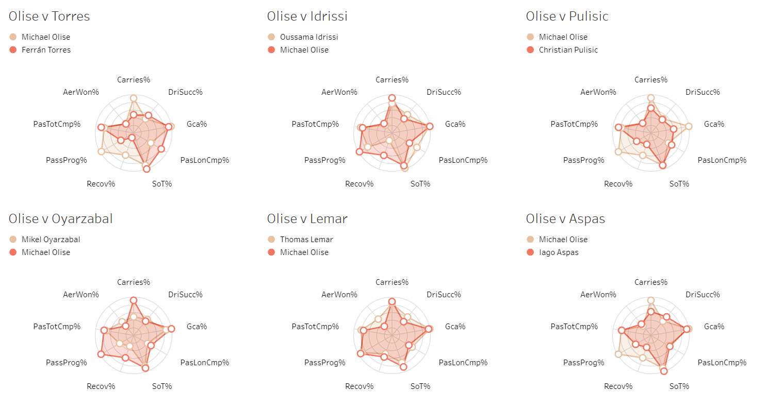
Radar Chart Comparison of Shortlisted Players
Winger Comparison

Slide 19
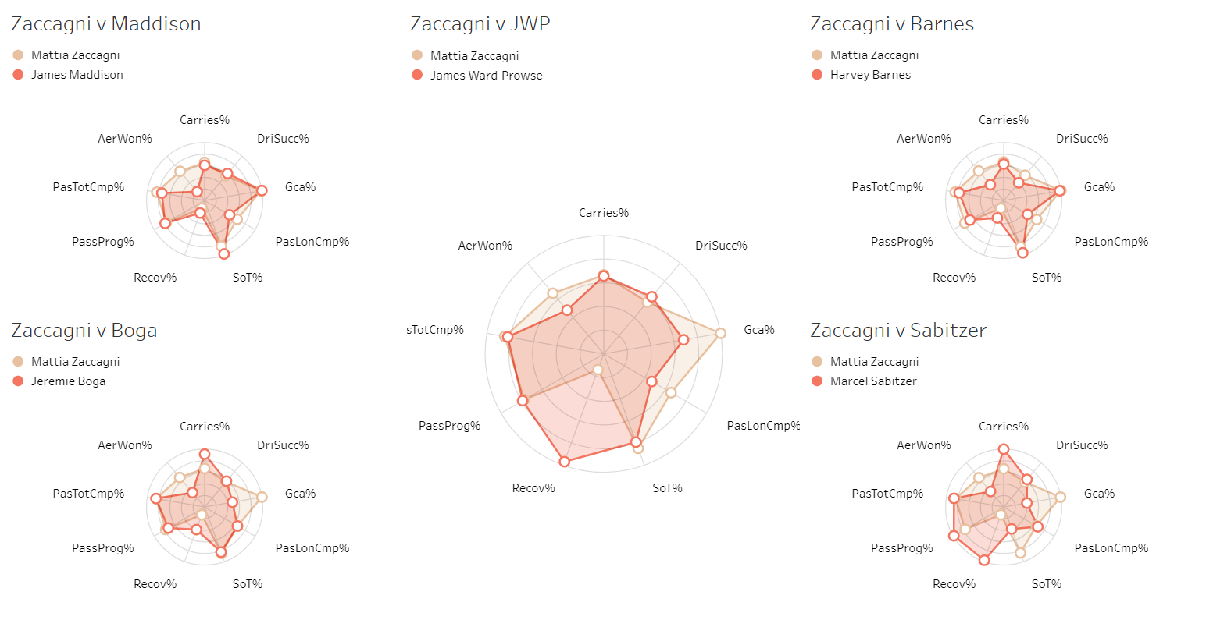
Radar Chart Comparison of Shortlisted Players
Creative Midfielder Comparison

Slide 20
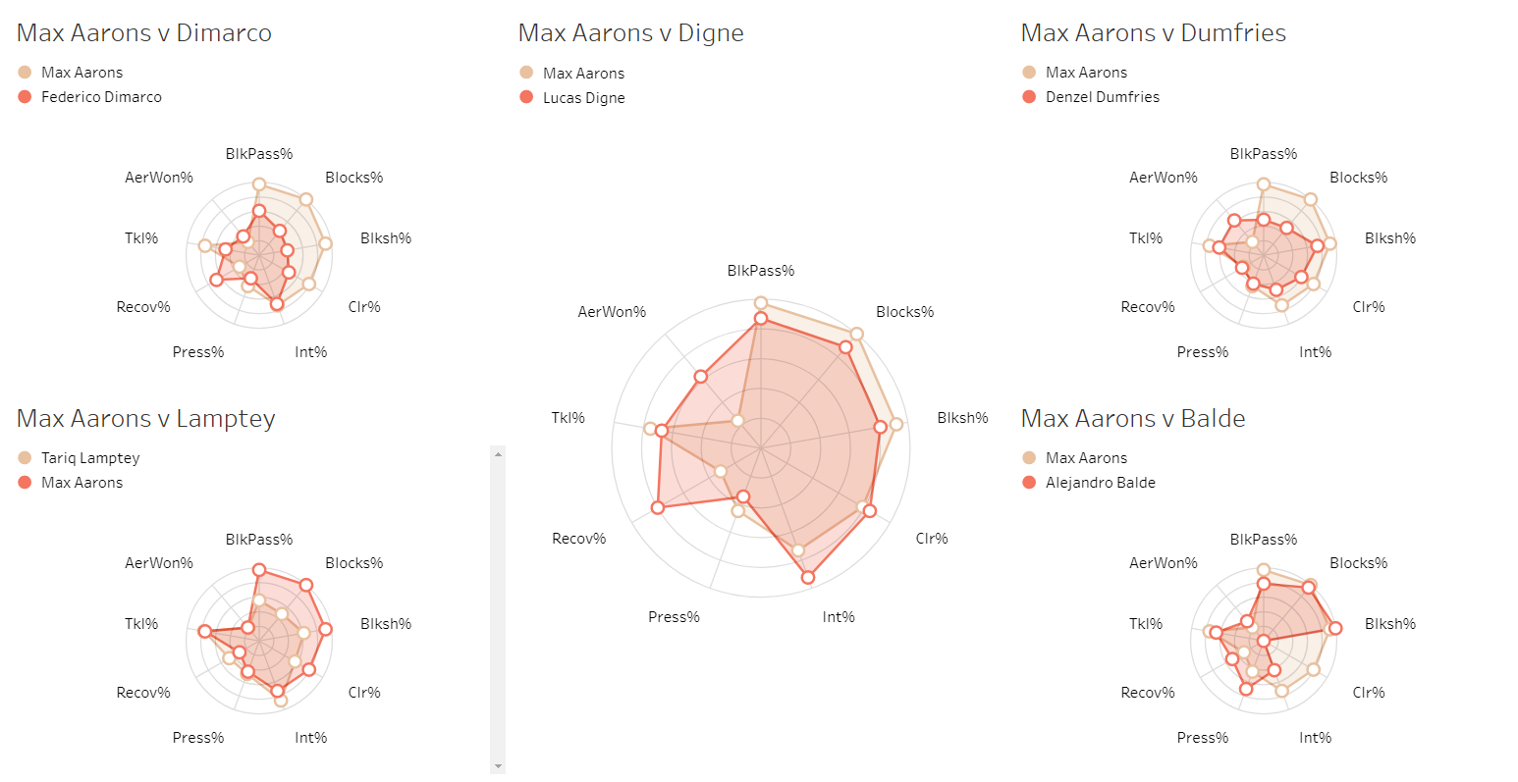
Radar Chart Comparison of Shortlisted Players
Left Back Comparison

Slide 21
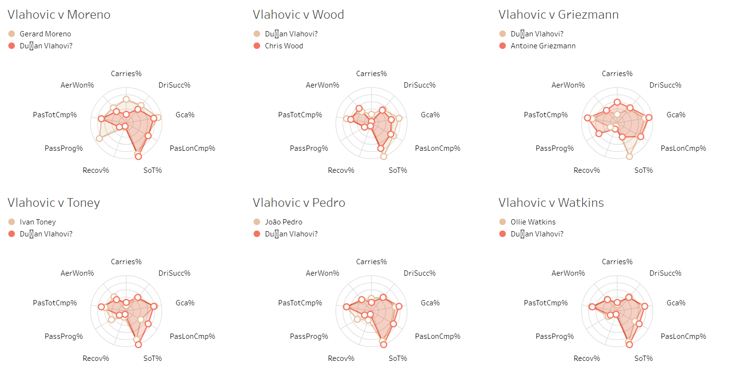
Radar Chart Comparison of Shortlisted Players
Striker Comparison

Slide 22
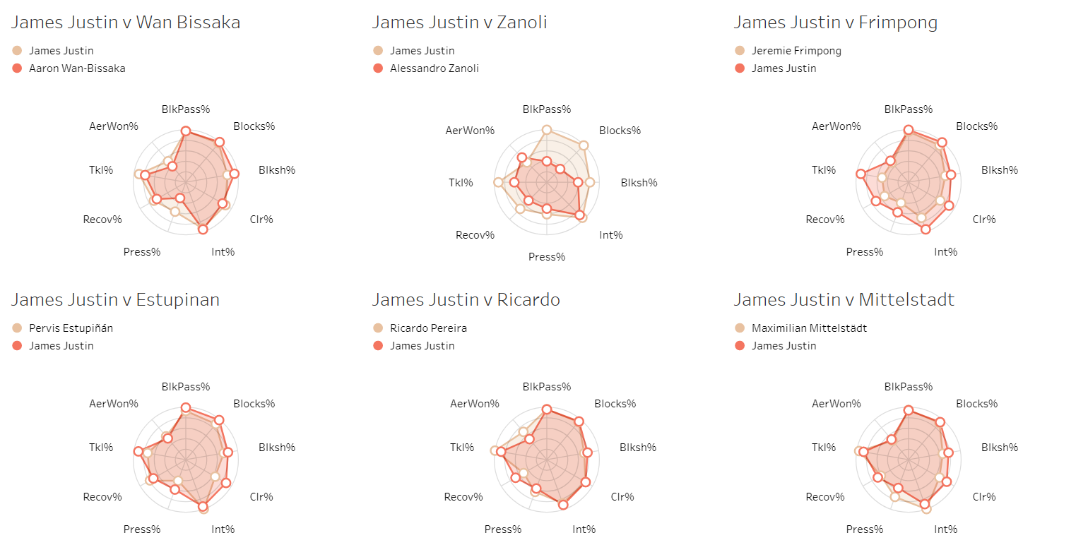
Radar Chart Comparison of Shortlisted Players
Right Back Comparison

Slide 23
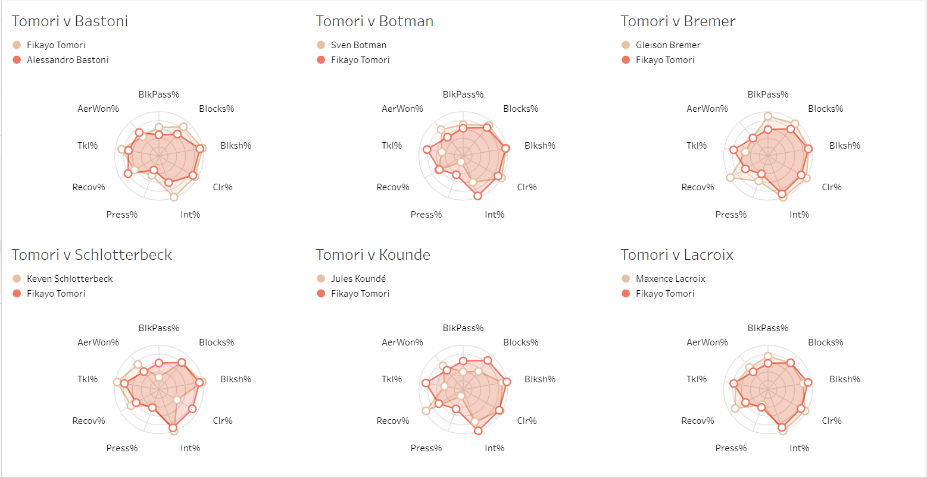
Radar Chart Comparison of Shortlisted Players
Center Back Comparison

Slide 24
Final Transfer Recommendations
Departures and Budget:
✅ Sold Players: Kane, Ndombele, Lo Celso, Winks, Sánchez, Doherty, Bergwijn, Gil, Emerson.
💰 Funds Raised: €218M
Strike Reinforcement
Antoine Griezmann (30M)
Gerard Moreno (40M)
Why these signings?
Griezmann: Versatile forward, experienced, creative playmaker.
Moreno: Proven goalscorer, strong finishing ability.
Midfield Upgrades (Sign 2 among)
Mattia Zaccagni (20M)
Marcel Sabitzer (25M)
Youri Tielemans (40M)
Why these signings?
Zaccagni: Agile, creative playmaker, strong dribbler.
Sabitzer: Versatile, hard-working, good passing.
Tielemans: Visionary playmaker, great defensive contribution.

Slide 25
Final Transfer Recommendations
Winger Reinforcement
Michael Olise (30M)
Thomas Lemar (25M)
Why these signings?
Lemar: Dynamic, quick, great dribbler.
Olise: Young, talented, excellent crosser & playmaker.
Defensive Upgrades
Fikayo Tomori (40M)
Maxence Lacroix (25M)
Why these signings?
Tomori: Fast, strong, excellent ball-playing CB.
Lacroix: Young, aggressive, solid defensively.
Full-Back Reinforcement
James Justin (20M)
Max Aarons (20M)
Mittelstadt (15M)
Why these signings
Aarons: Quick, reliable, strong defensively.
Justin: Versatile, experienced in Premier League.
Mittelstadt: Strong in both defense and attack.

Slide 26
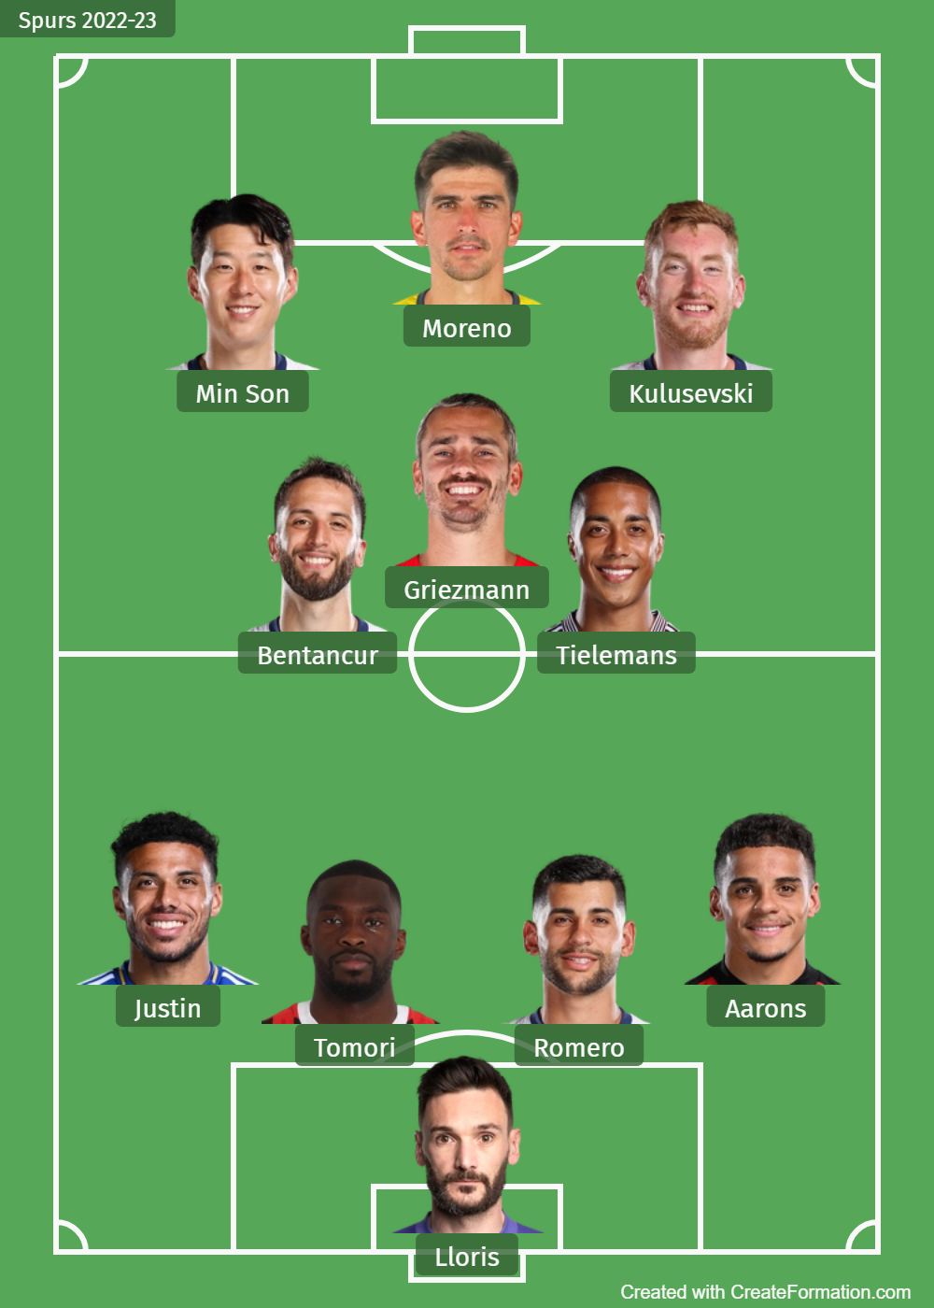
Projected Tottenham Lineup After Transfers
Formation
4-3-3
Attacking (High Press).
CAM position switched btw Zaccagni and Griezmann.
Olise, Lemar, Kulusevski and Son provides depth and quality.
Tomori, Justin and Moreno provides more aerial quality.
Justin and Aarons as Fullbacks insure threat in the box.
Tielemans plays as box to box
Bench
Olise
Lemar
Zaccagni
Lacroix
Reguilon
Mittelstadt
Hojbjerg

Slide 27
Conclusion and Next Steps
🎯 Expected Impact
More fluid attack without relying on Kane.
Stronger midfield control & creativity.
Defensively solid & well-balanced squad.
✅ Squad Transformation Complete
Strengthened attack with Griezmann & Moreno.
Reinforced midfield with Tielemans.
Upgraded defense with Tomori, Lacroix, Aarons, Justin, Mittelstadt.
Added creativity with Zaccagni Lemar & Olise for attacking depth.
📌 Next Steps
1️⃣ Build chemistry with new signings.
2️⃣ Experiment with formations (3-4-3 & 4-2-3-1).
3️⃣ Keep players fresh.
4️⃣ Target a Top 4 finish & deep cup runs.

